Slide 1

E-Commerce Website for Perfume Sales
by,
Ramireddy Thilak Kumar Reddy

Slide 2

ABSTRACT
This project is a simple online perfume store built for learning purposes.
The backend is built with Spring Boot, which sends hardcoded perfume data to the frontend.
The frontend is made with HTML, CSS, and JavaScript for an interactive browsing experience.
Users can view perfumes, explore details, and navigate pages.
No database or real payment system is used — the project focuses on demonstrating the basics of full-stack web development.

Slide 3

EXISTING SYSTEM
Traditional perfume sales are mostly done in physical stores.
Customers cannot see all products online.
There is no interactive website to explore perfumes.
Managing products and showing them online is time-consuming without a web system.

Slide 4

PROPOSED SYSTEM
An online perfume catalog with interactive browsing.
Spring Boot backend provides static data for perfumes.
HTML, CSS, and JavaScript frontend displays the perfumes dynamically.
Users can navigate between pages and view product details.
Helps understand how backend and frontend communicate in a web app.

Slide 5
ADVANTAGES
Easy to run locally — no complex setup required.
Beginner-friendly for learning full-stack development.
Interactive user interface with dynamic product display.
Can be extended later to include database or payment features.
Demonstrates real-world project structure on a small scale.

Slide 6
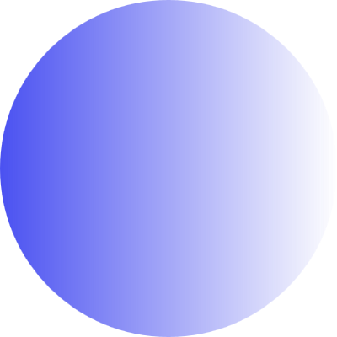
DISADVANTAGES
Data is static — new perfumes require code updates.
No login, shopping cart, or payment system.
Limited functionality — only for demonstration purposes.
Not suitable for production use.

Slide 7
HARDWARE REQUIREMENTS
Processor: Intel i3 or higher
RAM: Minimum 4 GB
Storage: Minimum 5 GB free
Monitor: 1024×768 resolution or higher

Slide 8
SOFTWARE REQUIREMENTS
Operating System: Windows / Linux / macOS
Backend: Spring Boot (Java)
Frontend: HTML, CSS, JavaScript
IDE: IntelliJ IDEA / Eclipse / VS Code
Browser: Chrome, Edge, Firefox

Slide 9
MODULES
Home Module – Shows featured perfumes and site navigation.
Product Module – Displays perfumes with images, names, and prices.
Backend Module – Sends hardcoded perfume data to the frontend.
Frontend Module – Displays perfume data and handles user interactions.
About/Contact Module – Provides static information about the site.

Slide 10
MODULE DESCRIPTION
Home Module: Entry page with navigation links and featured perfumes.
Product Module: Shows the list of perfumes and details for each product.
Backend Module: Spring Boot serves hardcoded data through APIs.
Frontend Module: Uses JavaScript to fetch data and display it dynamically.
About/Contact Module: Static pages with site info or contact details.

Slide 11
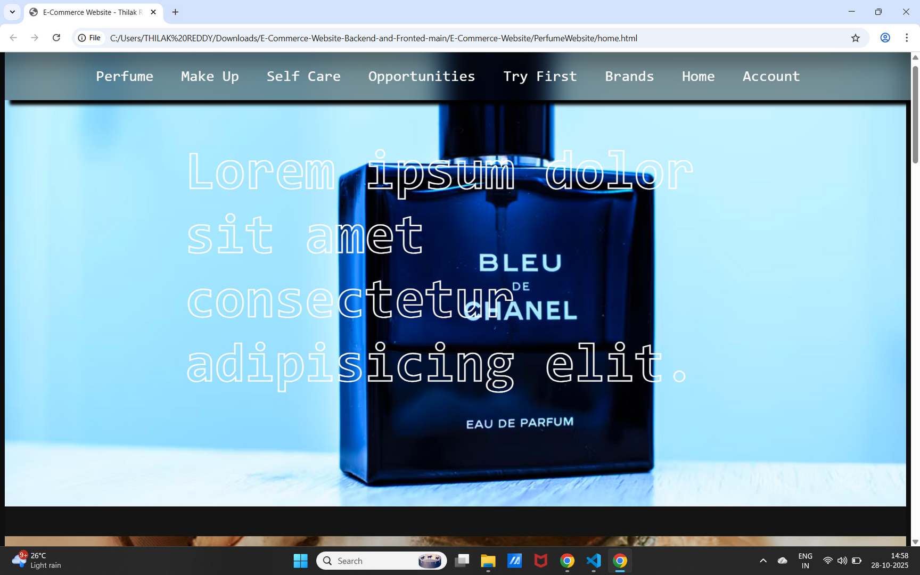
SAMPLE OUTPUT

Slide 12
CONCLUSION
The project successfully demonstrates a full-stack web application using Spring Boot and HTML/CSS/JavaScript without a database.
Provides an interactive interface for viewing perfumes.
Ideal for beginners to understand how backend and frontend work together.
Can be upgraded in the future to include a database, login system, or payment gateway.

Slide 13
Thank
You

